Slide 1

Event Management System
Presented by:
Jai Rao- 20104097
Hitesh Sachdev- 20104137
Tanmay Poyekar- 20104053
Nihaal Varun- 20104040
Project Guide
Ms. Sneha Dalvi

Slide 2
Contents
Introduction
Objectives
Scope
Features / Functionality
Project Outcomes
Technology Stack
Block Diagram

Slide 3
1. Introduction
An Event Management System helps organizers plan, execute and report on events.
Event management is the application of project management to the creation and development of small and large-scale personal or corporate events such as ceremonies, formal parties.
It involves studying the brand, identifying its target audience, devising the event concept, and coordinating the technical aspects before actually launching the event.

Slide 4
1. Introduction
Problem Identified :
    Each event is different in its nature so process of planning and execution of each event differs on basis of the type of event.
    A simple interface is critical to make event updates and tracking easy to maintain
Solution Proposed :
    event management system will allow users and organizers to access and manage all aspects of an event, including registration, marketing, physical planning and preparation, reporting and analytics, and more.
    Event Management System is a system that will reduce your work burden along with your budget,

Slide 5
2. Objectives
To Minimize administration efforts
To Eliminate missed communications
To Digitize how your events are run
To Save time planning future events
To Access detailed reports & analytics
To develop a system that effectively manages all the data related to the various events that take place in an organization.

Slide 6
3. Scope
Organize events such as theme parties, exhibitions, company conferences, musical concerts, etc.
Event Planning: To plan an event we consider the following areas of an event, feasibility, site choice/design, staging, site map, event proposal.
Maintaining a centralized database of all event related information

Slide 7
4. Feature /Functionality
Customized Processes & Scheduling:
    Custom processes in your event management system allow for designing and publishing online request forms, requiring approvals or additional information, and custom fields for different events to make sure you get all the information you need.
Effortless Event Updates & Tracking:
    Users can make changes to events, including time, date, status and services, 1 week before the event.
Resources & Documentation:
    Planners and users can able to attach all relevant services and documentation to any booking, as well as add comments where needed for easy reference.

Slide 8
5. Outcome of Project
User can book any event the want through login in there account.
Event Management System store all records of your events in a single Database System, so it becomes very easy to search any record if needed.

Slide 9
6. Technology Stack
Write what you have planned to develop front end ( GUI ) & Backend (Database if applicable)
Software used(GUI): HTML, CSS
Language: Python
Backend (Database): Python

Slide 10
7. Flow Diagram
Start
Select Event
registered
Already Registered
New User
Registration
Payment
Valid Password
Registration
Successful
Confirmation
Logout
Login
Invalid Password
Stop
Authentication

Slide 11
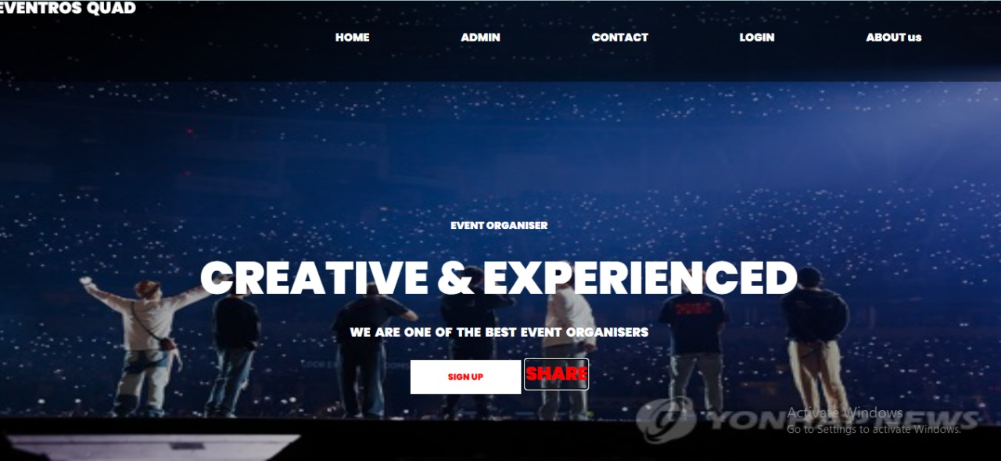
Implementation

Slide 12
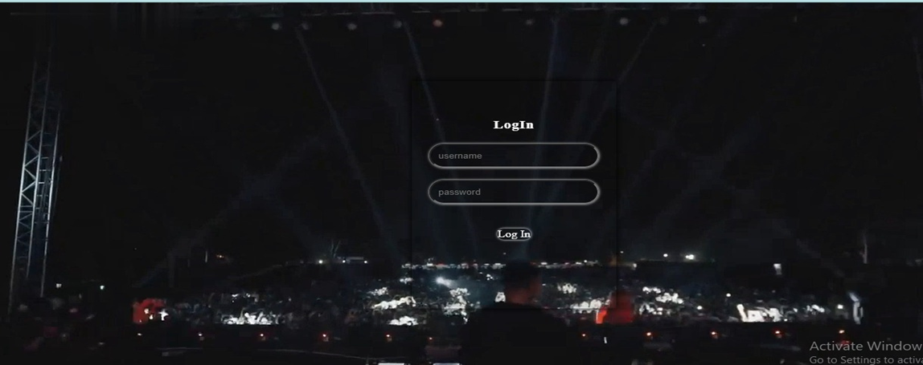
Implementation
Login Page

Slide 13
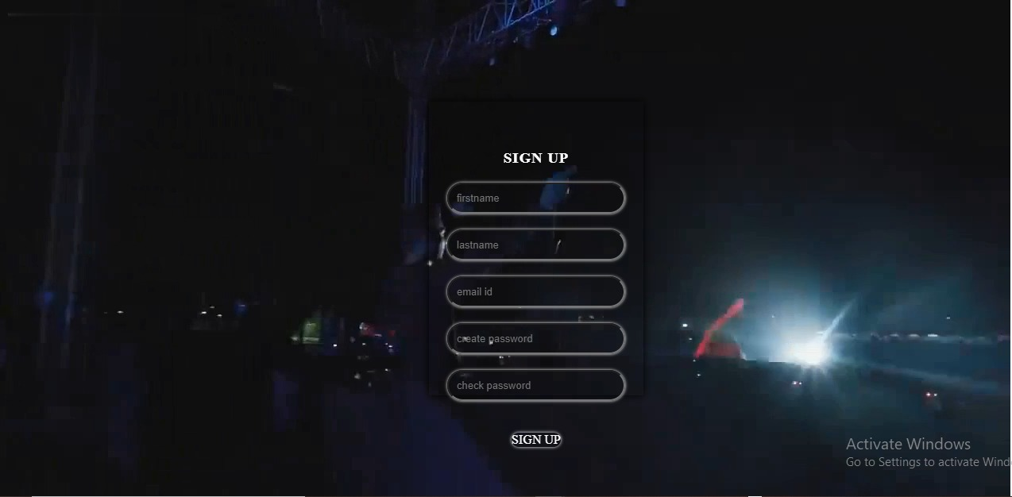
Implementation
Sign up page

Slide 14
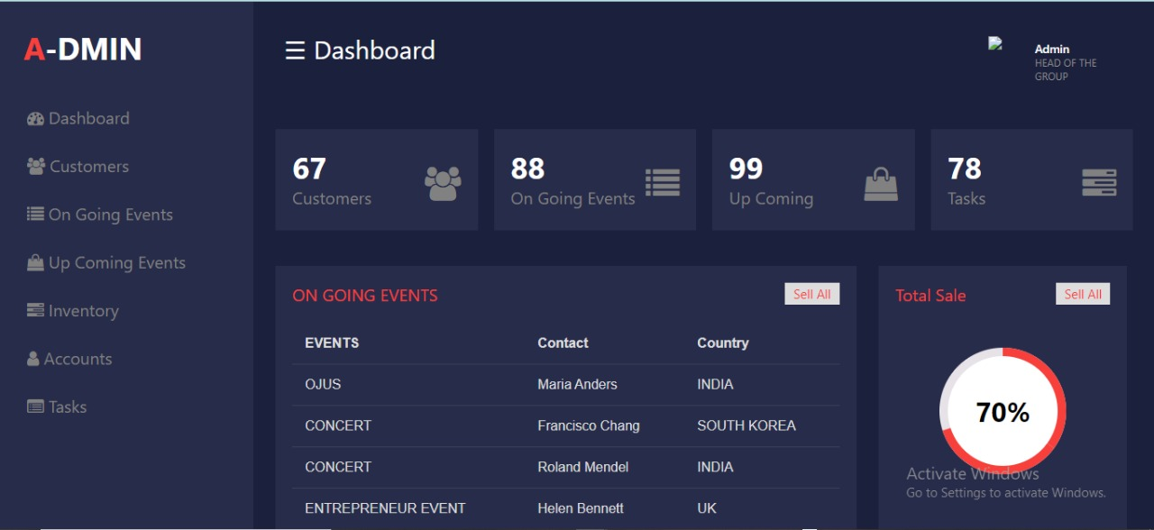
Implementation
Dashboard

Slide 15
Thank You...!!

